Slide 1

JAZAN UNIVERSITY SPS
One up top team
Under the direct supervision of
Dr. Imad M. Alshiekh

Slide 2
Abstract
Jazan university smart parking system is a small project that has been presented to represent solutions for the parking issue at Jazan University.
Parking detector is a small device by which we can determine if there is a car on the park where the device is laying on or not.
The device works by measuring the distance between it and the object in front of it(which is supposed to be a car), and uploading the information to global MySQL database on the world wide web.
The user can easily access the system through our website or using our android app.

Slide 3

Introduction
JAZAN UNIVERSITY SPS (or Smart Parking System) is a graduation project at Jazan university to provide a solution for a common problem that annoying all the staff members along with the students to find car parking in short time and less effort.
Based on controlling and measuring units, this project will be able to help the users by finding their parks in a few minutes.

Slide 4
Project goals and objectives.
Provide a free park for each member of the university (staff or students) so fast and in a professional way.
Save time and efforts.
Enhance the performance of the transporting plans at the university or any place in the future.

Slide 5
Project scope:
The project shall consider among other things the following issues:
1. To provide a better understanding of how to get your park so easily.
2. Implementing the system on different platforms
3. Take benefits from the Technical Era that we are living in.
4. provide a new scheme for the organizations in general to help in the parking issue.

Slide 6
Limitations and constraints
Limitations:
Some drawbacks of SPS are as follows:
It needs a pre setup in any parks.
It should be connected all the time to the internet.
It needs a maintenance over time.
Finally, it needs a full team to handle all the aspects of the project.

Slide 7
Constraints :
The following are some constrains in the proposed system:
Network Connection with an average speed is needed.
An " Parking detector " on each park spot we have
Server down leads to the system to be dead.
The connection should be more then reliable, Arduino or "Parking detector" needs to update it's state every 3 seconds.

Slide 8
Assumptions :
In the proposed system the following assumptions are made:
Administrator can create and handle the server and the clients.
A full team to work on the project
The server is already online.

Slide 9
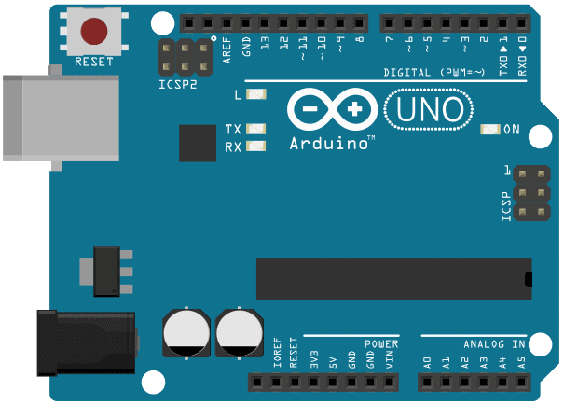
Major Components
Arduino Uno
Arduino is an open-source prototyping platform based on easy-to-use hardware and software. You can tell your board what to do by sending a set of instructions to the microcontroller on the board.

Slide 10
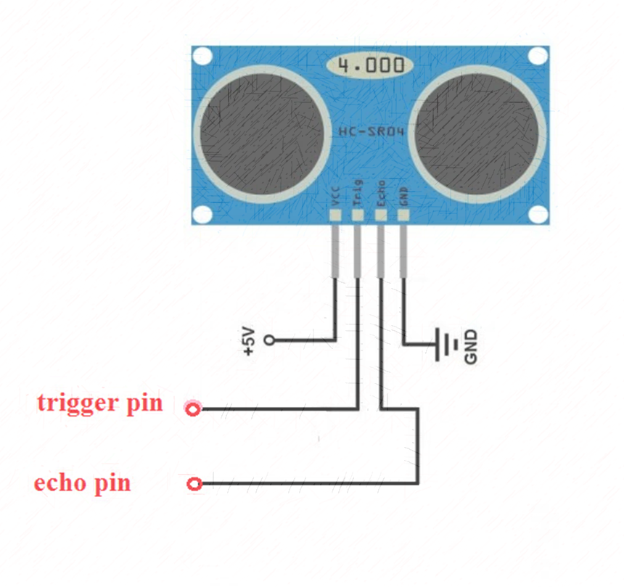
2.Ultrasonic Sensor
The HC-SR04 Ultrasonic Sensor is a very affordable proximity/distance sensor that has been used mainly for object avoidance in various robotics projects .

Slide 11
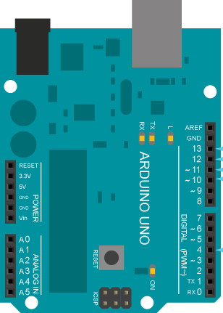
3.And Finally, the Ethernet shield
The Arduino Ethernet Shield connects Arduino to the internet in mere minutes.
That’s will help in sending and fetching data from internet and interact with deferent environments.

Slide 12
How does it work ?
By mixing the previous components, we came out with a suitable name for the system(SMART PARKING SYSTEM) and we named the device that going to detect the signals in the parking spot” Parking detector”.
This device will send an electronic pulses to measure the distance between the device and what ever above it, Thus it will determine wither there is a car on its position or not.
Each unit should be installed on every single park to be responsible for the car above it.
The next picture will illustrate that point

Slide 13



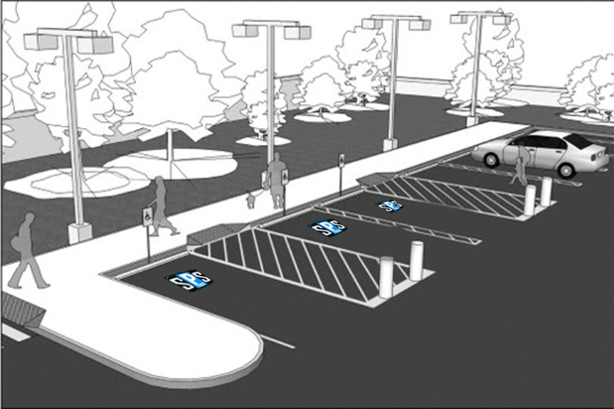

System architecture

Slide 14
User’s interaction methods with the system
We’ve created two main methods to make the user interact with our system and get benefits from it.
These methods are :
World Wide Web.
Android Platform.

Slide 15

1.The Internet
User can see the results of his search for the free park by easily accessing the following web page:
www.jazanu-sps.com
And then he will be free to choose his park and get directions to it.

Slide 16
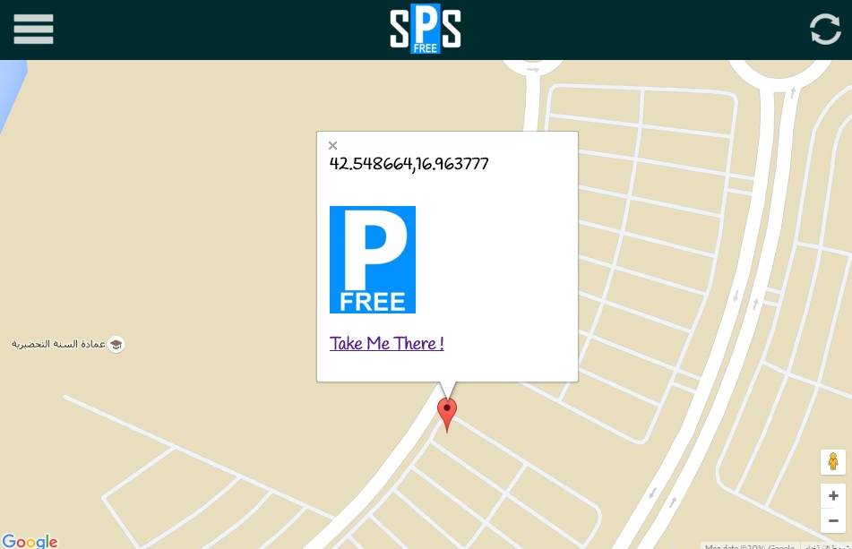

Slide 17

2.Android
User can download our app(for free) from the official apps store of android which is called Google Play and do the same as on the web site.
The program under the name ”JAZANU SPS”.

Slide 18
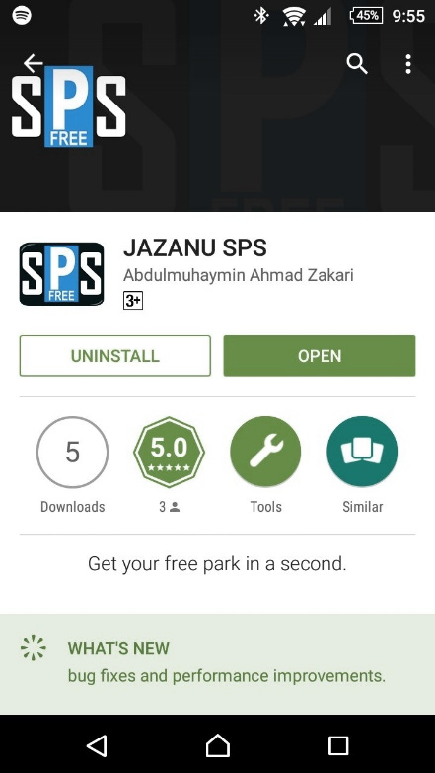
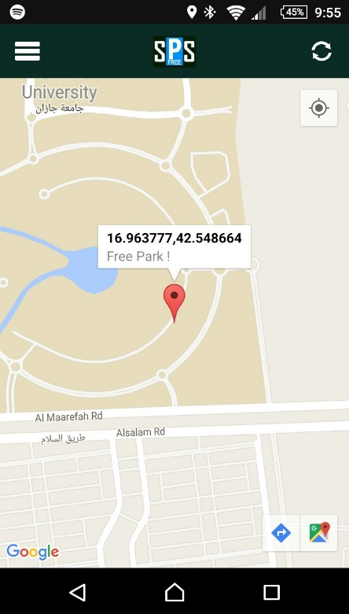

Slide 19
Thank you

